Slide 1

AWS Security Dashboard
By Sam Barrionuevo

Slide 2
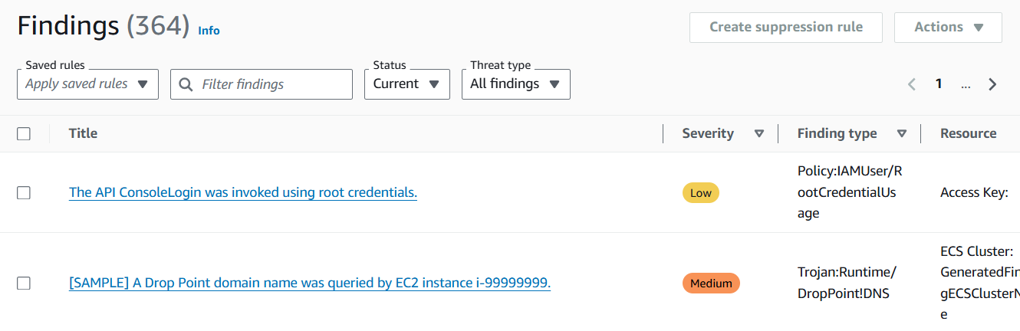
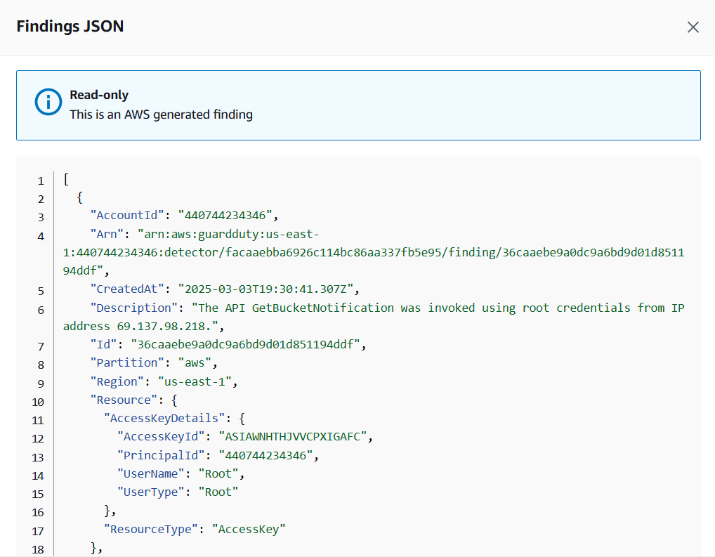
The cloud security challenge
The increasing reliance on AWS cloud infrastructure brings more security threats
Amazon GuardDuty and CloudTrail findings are separate and difficult to aggregate
Furthermore, raw GuardDuty and CloudTrail logs are complex and hard to interpret
Security professionals need real-time access to data to appropriately allocate time and resources
The solution needed is something to dynamically update and aggregate security threats in a clear graphical format
**Solutions need to be compliant as well as streamlined**

Slide 3
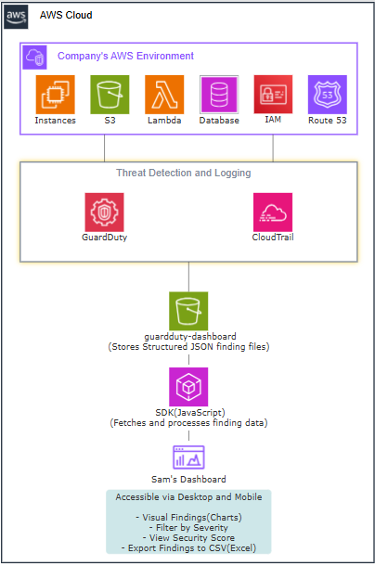
Solution overview
My dashboard is designed to collect data from a VPC or a selected group of instances
The dashboard dynamically collects GuardDuty and CloudTrail findings
All results are sent to S3 which filters and prioritizes findings by threat level
The dashboard updates to provide real-time insights with a security score for dynamic updates
The results are readily available for desktop and mobile users in a clean, compliant, and intuitive format

Slide 4


Scan now To See on your mobile device
Brita Tamm
502-555-0152
brita@firstupconsultants.com
www.firstupconsultants.com

Slide 5
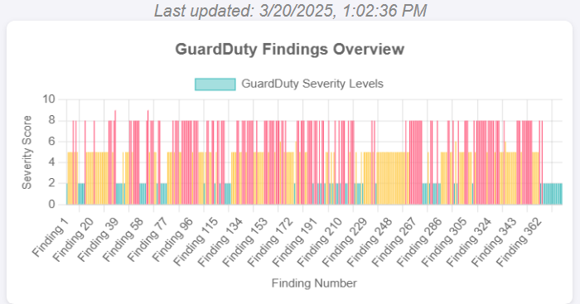
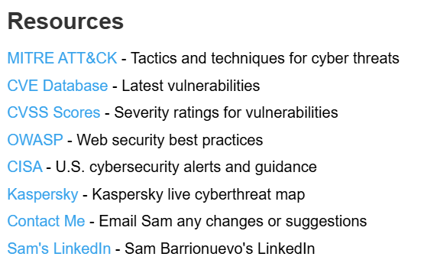
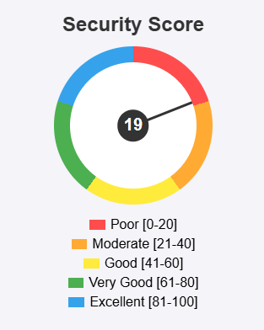
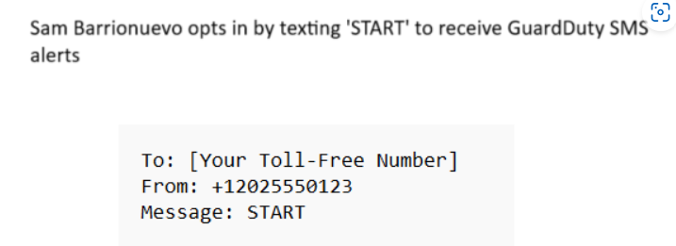
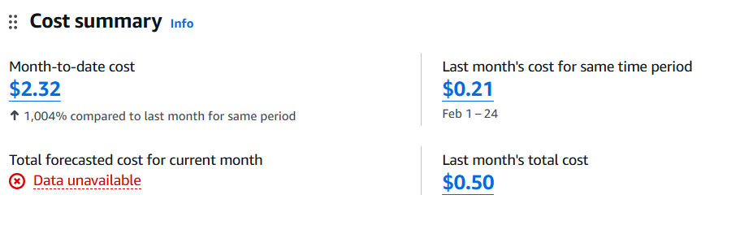
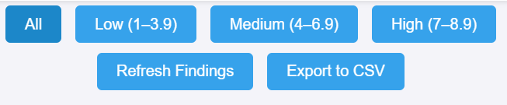
Key Features Sam Barrionuevo's GuardDuty Dashboard & SMS
Findings visualization
Recent Findings Log
Scoring gauge - (security score)
Findings Filtering and sorting
Export features
Resources Section
Security alert sign up
Cost Tracking for solution budget

Slide 6
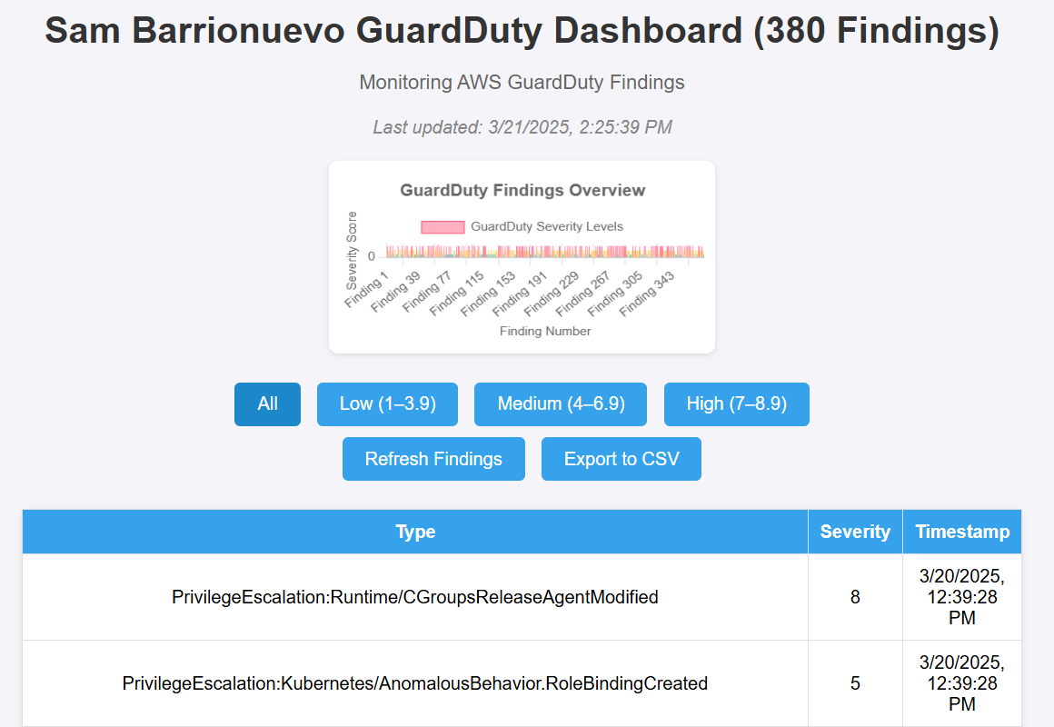
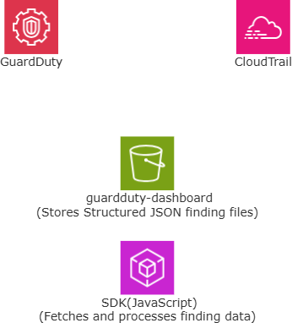
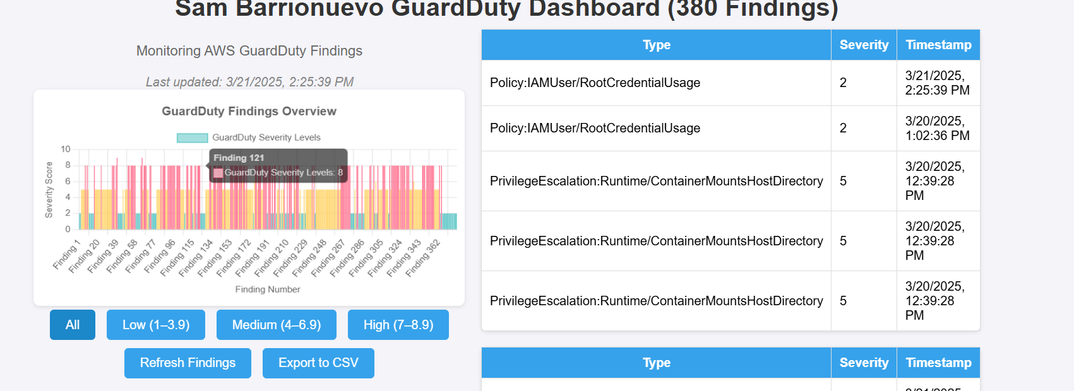
How I built it - Technologies
AWS S3 – Hosts dashboard and aggregates logs
AWS GuardDuty - Detects Security Threats
AWS CloudTrail - Tracks activity logs from users
AWS SDK and JavaScript - Fetches security findings
Chart.js library - Creates the visuals within the dashboard for clean presentation
AWS Billing - Tracks total cost of the solution
HTML/CSS/JavaScript - HTML structures the webpage, CSS styles the layout, JavaScript drives interactivity(buttons/findings)

Slide 7
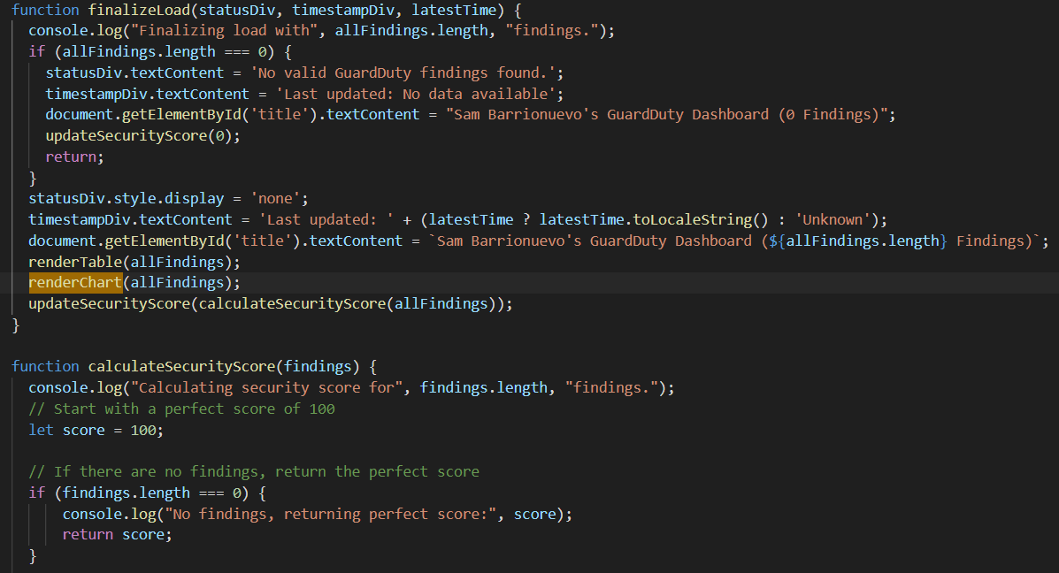
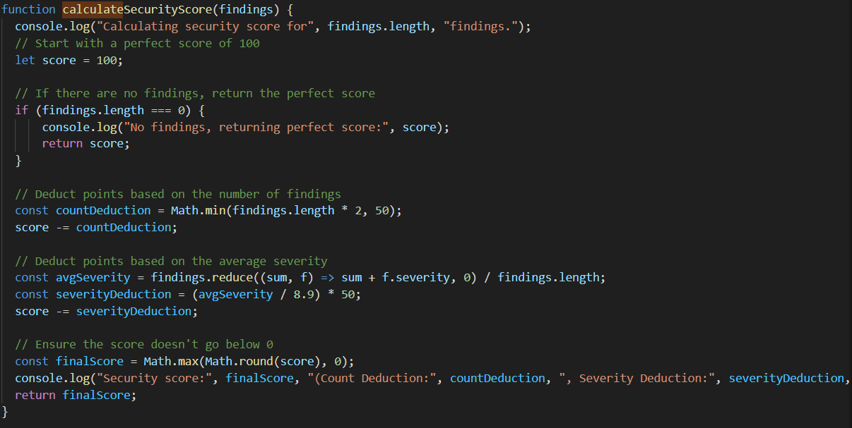
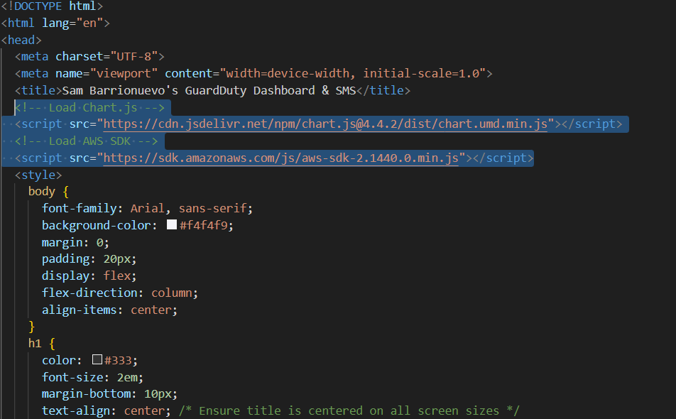
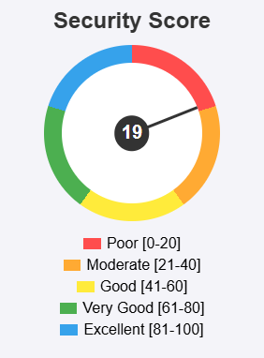
Dashboard code components

Slide 8
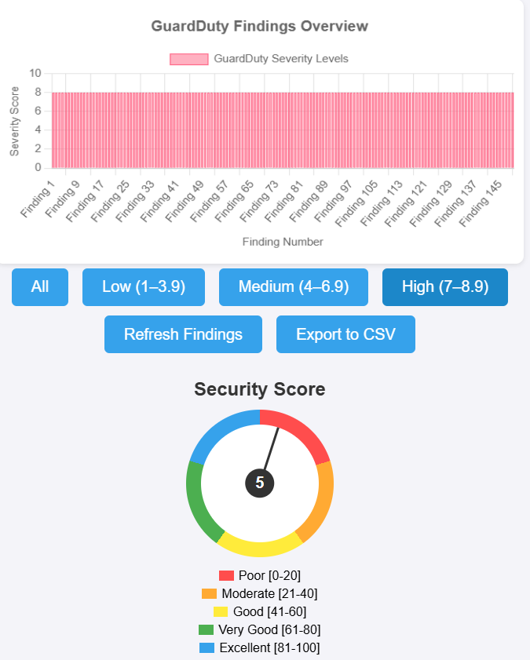
Severity Score calculation
Perfect Start - Security score begins at 100 and stays perfect if no findings exist
Deductions - Score drops up to 50 points for number of findings and up to 50 for average severity(0-8.9)
Final Score - Combines deductions ensuring the score is 0 or higher and rounds it accordingly
Gauge Wheel - Maps the score from (0-100) to a 360⁰ needle rotation, showing security level visually
Bar Chart – Displays the findings severity(0-10) with color coding: red (high, ≥7), yellow (medium, 4-6.9), green (low, <4)
Purpose – Evaluates AWS instance security from GuardDuty/CloudTrail findings with a score and visuals for security professionals

Slide 9


Alternatives: Why Build a Dashboard
Solutions | Pros | Cons
AWS GuardDuty (Alone) | Built In AWS threat detection Identifies threats No setup, just enable it | Limited customization No advanced visualization Not user optimized
CloudTrail (Alone) | Full visibility of user activity Crucial for audits/compliance Easy to export logs | Raw log format is messy Non-security specific No visualization or scoring
Custom Dashboard | Cost effective (Budget) Compliant Fully customizable Design for mobile/desktop Hands on AWS implementation | Requires manual setup and coding Limited to implementation scope
AWS Security Hub | Native AWS Integration Centralized View of Findings Supports AWS products | Limited customization No advanced visualization Not user optimized
Third-Party SIEM Tools | Powerful analytics Built-in Dashboards Efficient Alerting Enterprise grade features | Extensive licensing Learning curve for users Compliance concerns

Slide 10

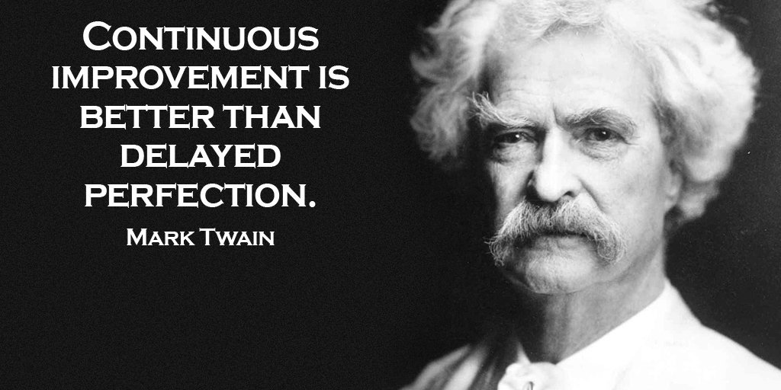
Further Enhancements
-Automated incident responses
- Have multiple dashboards per VPCs or selected instance groups
- User authentication in AWS Cognito
- SMS alerting system

Slide 11
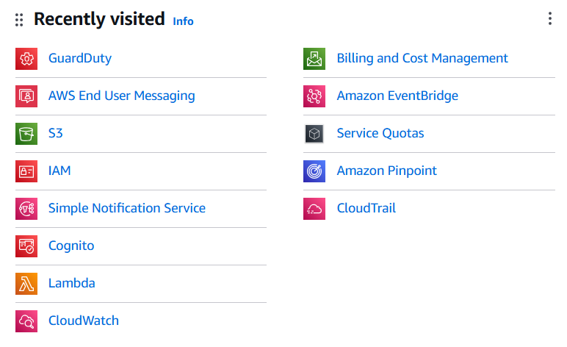
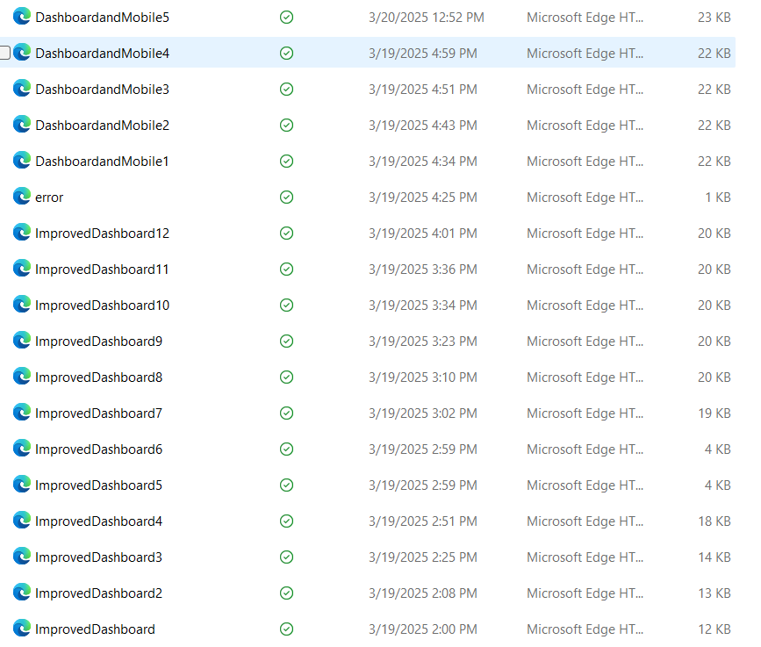
Thank you
Questions?

